Slide 1
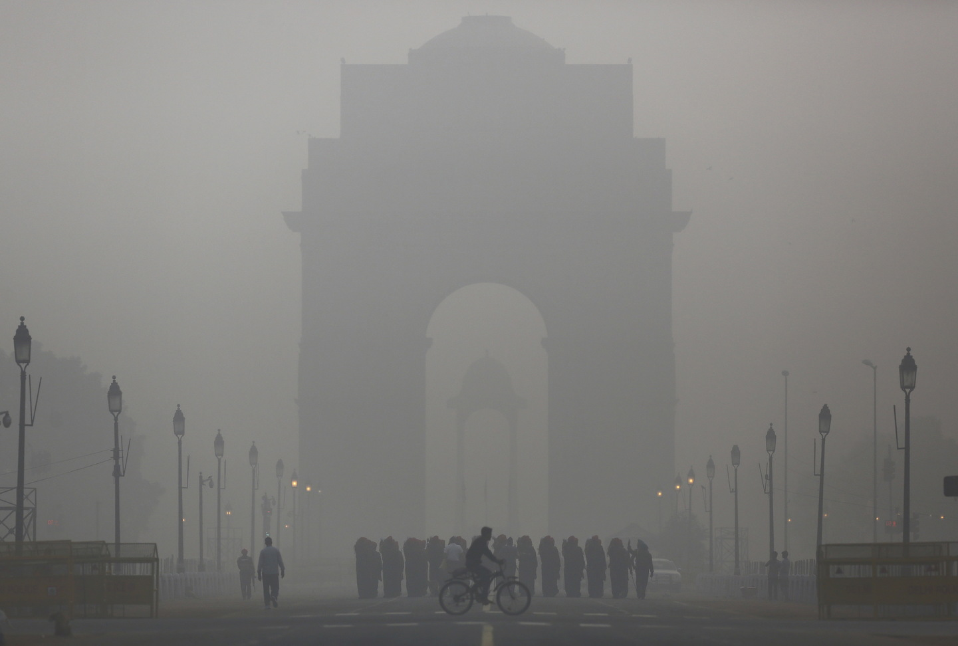
India Air Quality
Exploratory Data Analysis
Term 2 End Project
Neeraj Kumar

Slide 2
Air, the most important thing to have life on the planet. Air pollution has been one of the serious issues in India and hence we are looking here to analyse the different air pollutants of different state and cities of India.

Slide 3
Problem Statement : Are we breathing safe ?
Air pollution occurs when harmful or excessive quantities of substances including gases, particles, and biological molecules are introduced into Earth's atmosphere.
The Pollutant Standard Index (PSI) is a numerical value and indicator of pollutants that is normally used to facilitate risk assessment.
It is a numeric value between zero to 500. The calculation of PSI is based on the concentration of five major air pollutants including particulate matters (PMs), sulphur dioxide (SO2), nitrogen dioxide (NO2), carbon monoxide (CO), and ozone (O3) in the air.

Slide 4
5 important factors in air to analyse the air quality
NO2
Nitrogen Dioxide and is emitted mostly from combustion from power sources or transport.
SO2
Sulphur Dioxide and is emitted mostly from coal burning, oil burning, manufacturing of Sulphuric acid.
Suspended particulate matter with diameters less than 2.5 micrometres. They tend to remain suspended for longer durations and potentially very harmful.
SPM
Suspended particulate matter and are known to be the deadliest form of air pollution. They are microscopic in nature and are found to be suspended in earth's atmosphere.
RSPM
Respirable suspended particulate matter. A sub form of spm and are responsible for respiratory diseases.
pm2_5

Slide 5
Data Set
EDA is performed on following data.
Number of variables : 11
Number of observations : 435742
Total Missing (%) : 19.6%
37 State data
6 type of data i.e. of industry, rural etc.
Data is of year 1987 to 2015

Slide 6
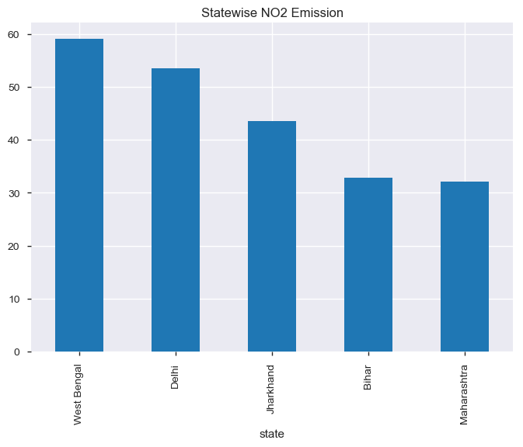
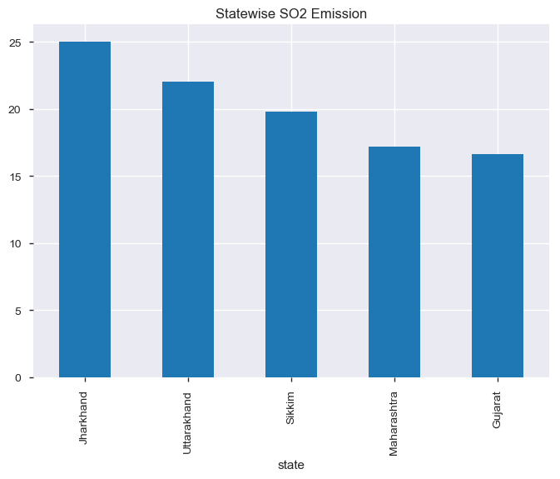
Top 5 states having highest emissions of NO2 & SO2
Jharkhand and Maharashtra emitting SO2 and NO2 most in India.

Slide 7
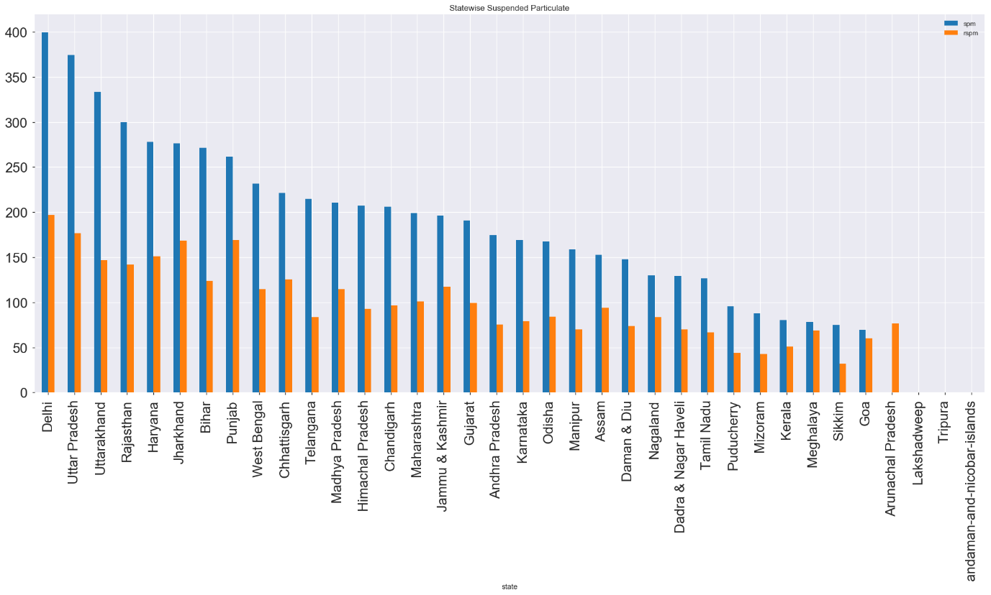
Suspended particulate matter state wise
Delhi & UP adding most to SPM and RSPM in air

Slide 8
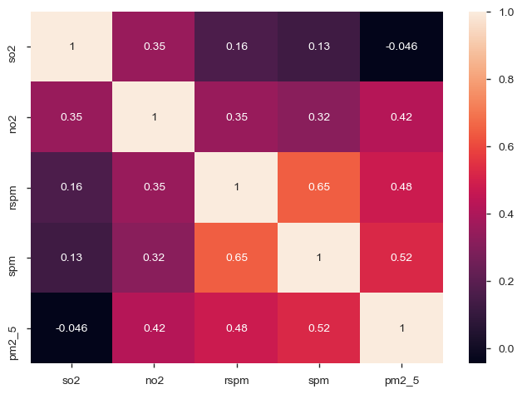
Correlation between pollutant
SPM and RSPM having higher interdependency and then followed by RSPM and NO2

Slide 9
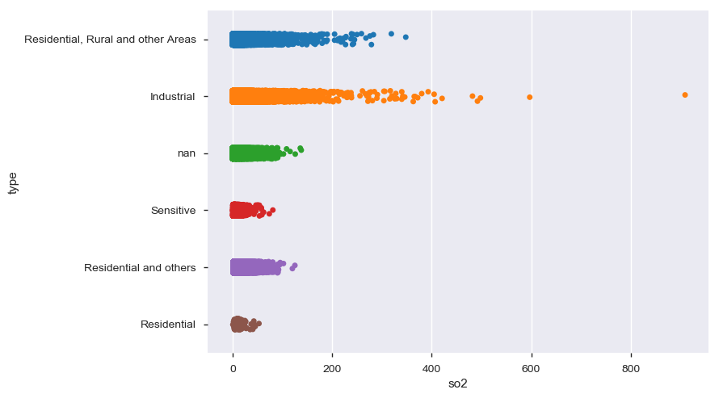
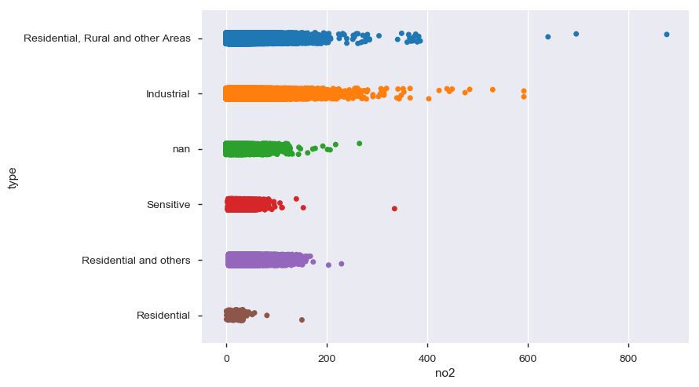
Industrial area : major reason behind producing the air pollutant
Industrial area leading the emission of SO2 and NO2.

Slide 10
Conclusion
North and east states are highly polluted.
South and west states are better to breath and comparatively less polluted to other part of India.
Industrial area is clearly the major reason behind producing the air pollutant.
Delhi & UP adding most to SPM and RSPM in air.
Jharkhand and Maharashtra emitting SO2 and NO2 most in India.

Slide 11
Thanks

